Slide 1
Simulation Backend and Frontend Study Group 11 01/28/2025

Slide 2
01
Backend
02
Frontend
03
Simulation game today
04
Deployment on cloud

Slide 3
Backend
01

Slide 4
Now we call ourself “backend”

Slide 5

Now we call ourself “backend”
If you work is
1. algorithm design (アルゴリズム設計)
2. framework building (フレームワーク構築)
3. model deployment (モデルデプロイ)

Slide 6



Now we call ourself “backend”
1. Select one language
1. collecting background information
2. making assunptions
3. desgin algorithms
1. Coding

Slide 7

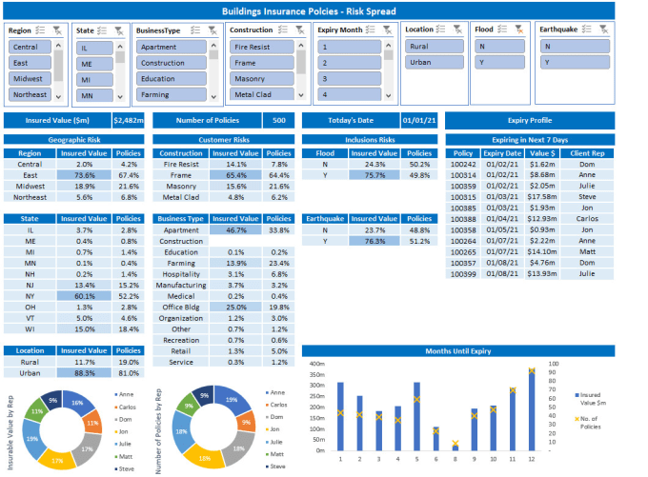
Now we call ourself “backend”
Compared to programming languages, Excel is special because (I notice Ojima kun and Maeda kun, Tanaka kun sometimes use EXCEL):
Excel is good at:
(Excelが得意とする分野：)
1. Business Analysis & Reporting
(ビジネス分析・レポート作成)
2. Data Management & Visualization
(データ管理・可視化)
3. Quick Prototyping & Testing
(素早いプロトタイピングとテスト)
4. Simple, visual, and business-focused.
(シンプルで、視覚的で、ビジネス指向)

Slide 8
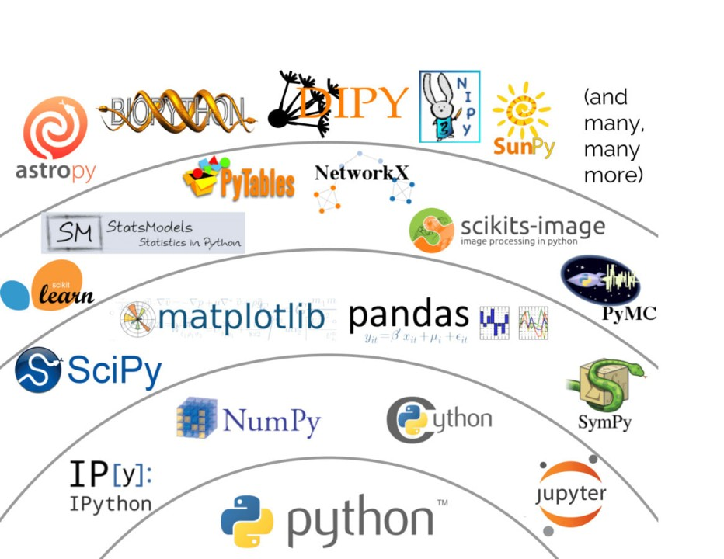
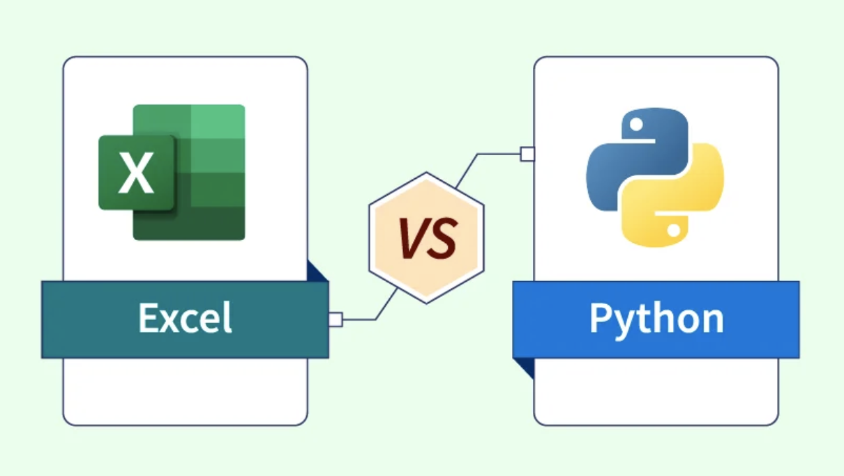
Now we call ourself “backend”
Python's strengths lie in:
(Pythonの強みは：)
Rich Open Source Ecosystem
(豊富なオープンソースエコシステム)
NumPy, Pandas, Matplotlib
Machine Learning: scikit-learn
Data Science: SciPy, Jupyter

Slide 9
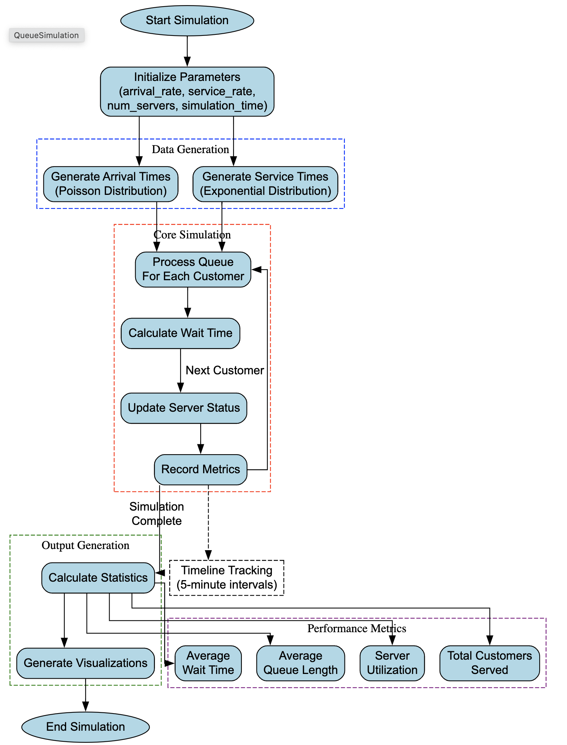
Let us start a simple backend
1. Open a the link
https://colab.research.google.com/drive/1wtc6RE4jyO1euXrMwO3tNUAheTxPuWAs?usp=sharing
Example of Queue Simulation System
This system simulates a multi-server queuing system
Inputs:
arrival_rate: How many customers arrive per hour
service_rate: How many customers each server can serve per hour
num_servers: Number of service points (e.g., counters, tellers)
simulation_time: How long to run the simulation (in minutes)
Outputs:
Performance Metrics
Visualizations

Slide 10
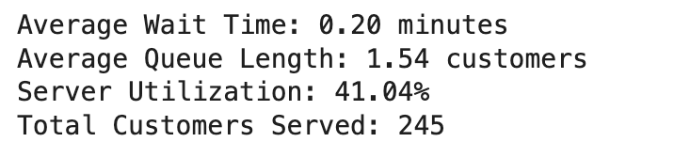
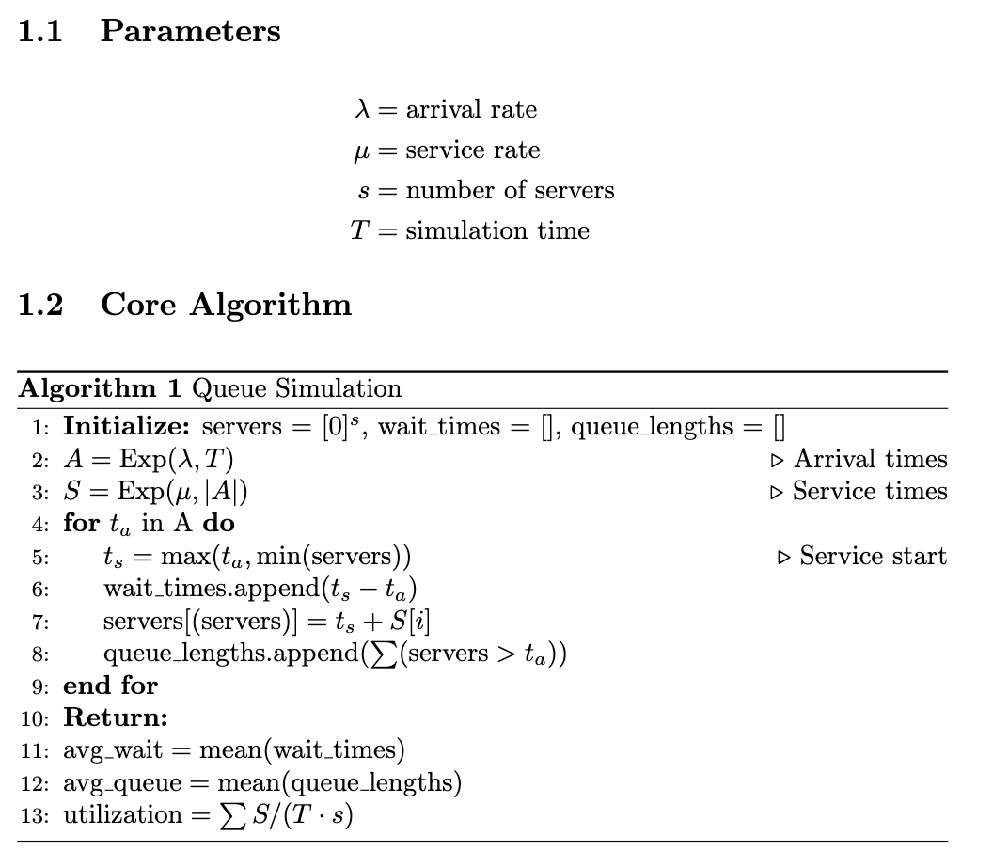
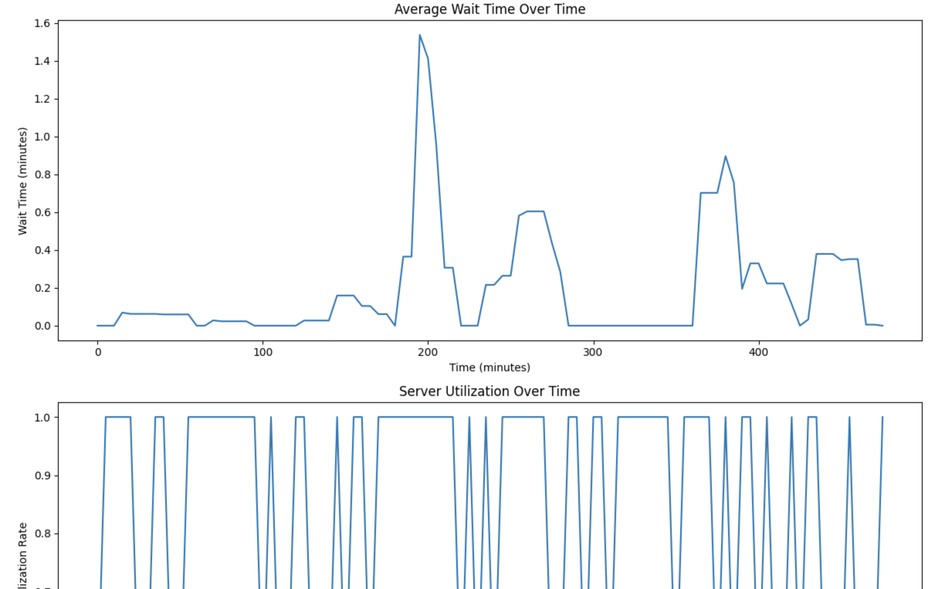
Let us start a simple backend

Slide 11
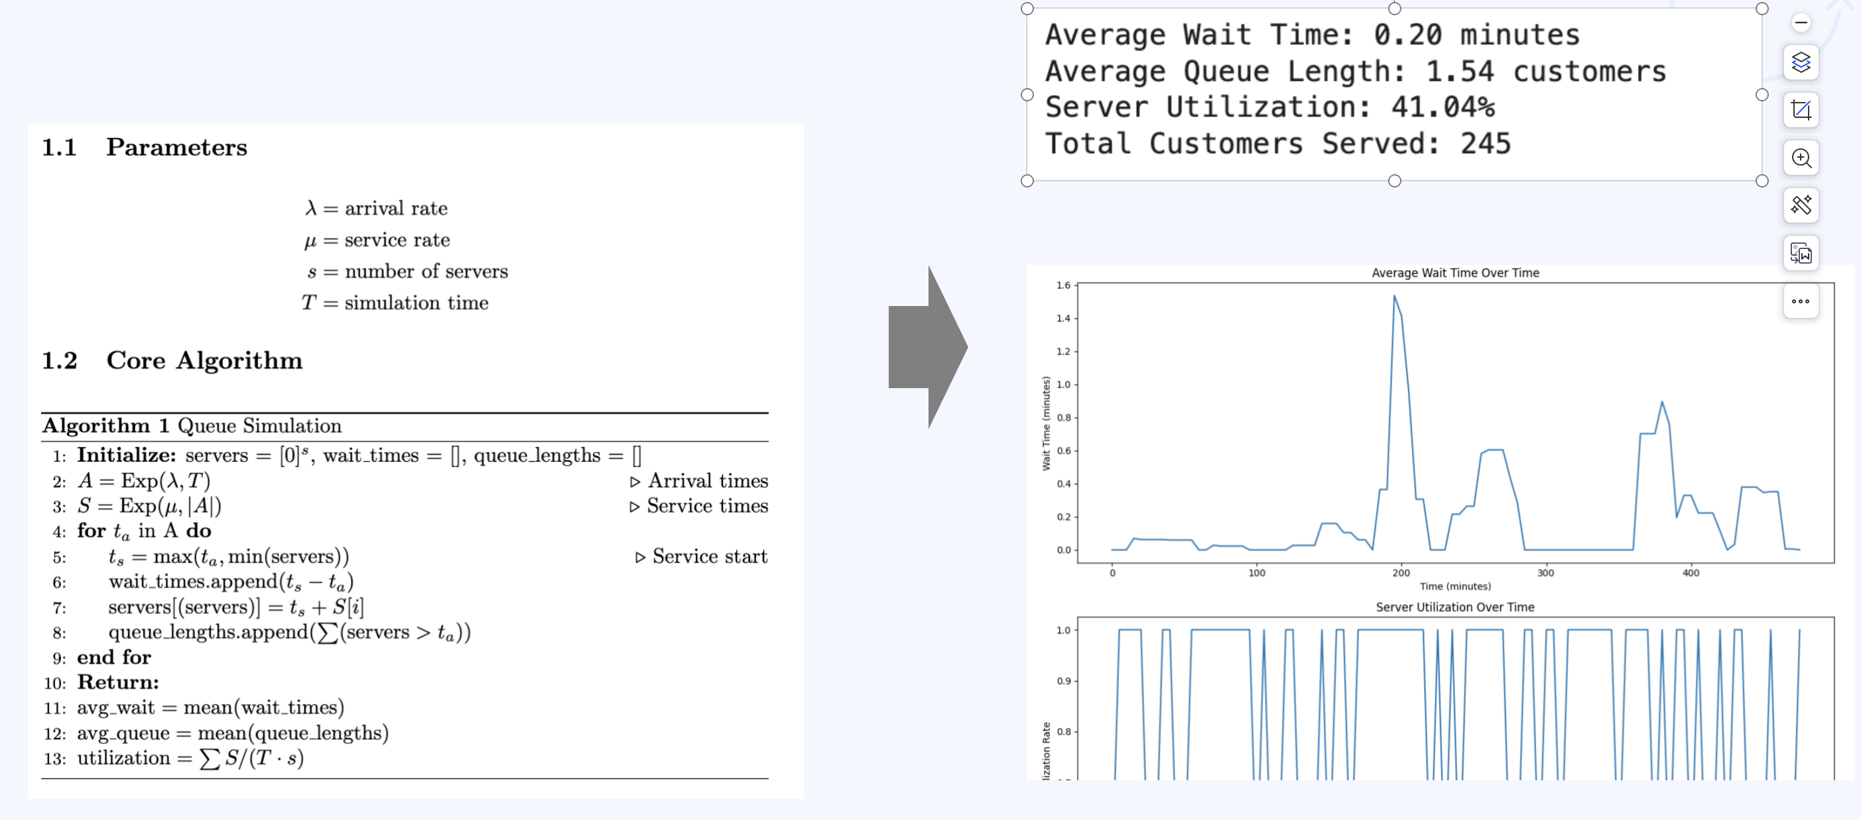
Let us start a simple backend
By doing this we find it is very difficult to interact
1. less interaction functions
2. high reply on the environment
- package
- python environment
3. It is very difficult to exchange with others

Slide 12



Let us start a simple backend
By doing this we find it is very difficult to interact
1. less interaction functions
2. high reply on the environment
- package
- python environment
3. It is very difficult to exchange with others
Also you can choose
Add frontend

Slide 13
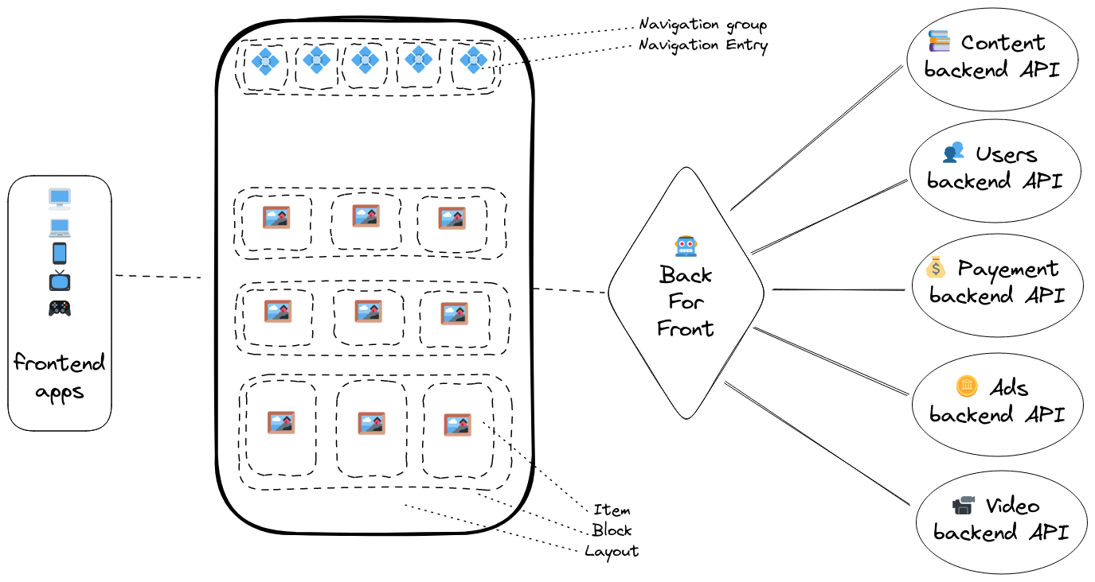
Frontend and Backend
Frontend
Backend
Backend Responsibilities (バックエンドの責務)
API Services
Data Processing
Business Logic
Security & Authentication
(APIサービス、データ処理、ビジネスロジック、セキュリティと認証)
Frontend Responsibilities (フロントエンドの責務)
User Interface & Experience
Layout and Design
Client-side Logic
Data Presentation
(ユーザーインターフェース・体験、レイアウト、クライアントサイドロジック、データ表示)

Slide 14
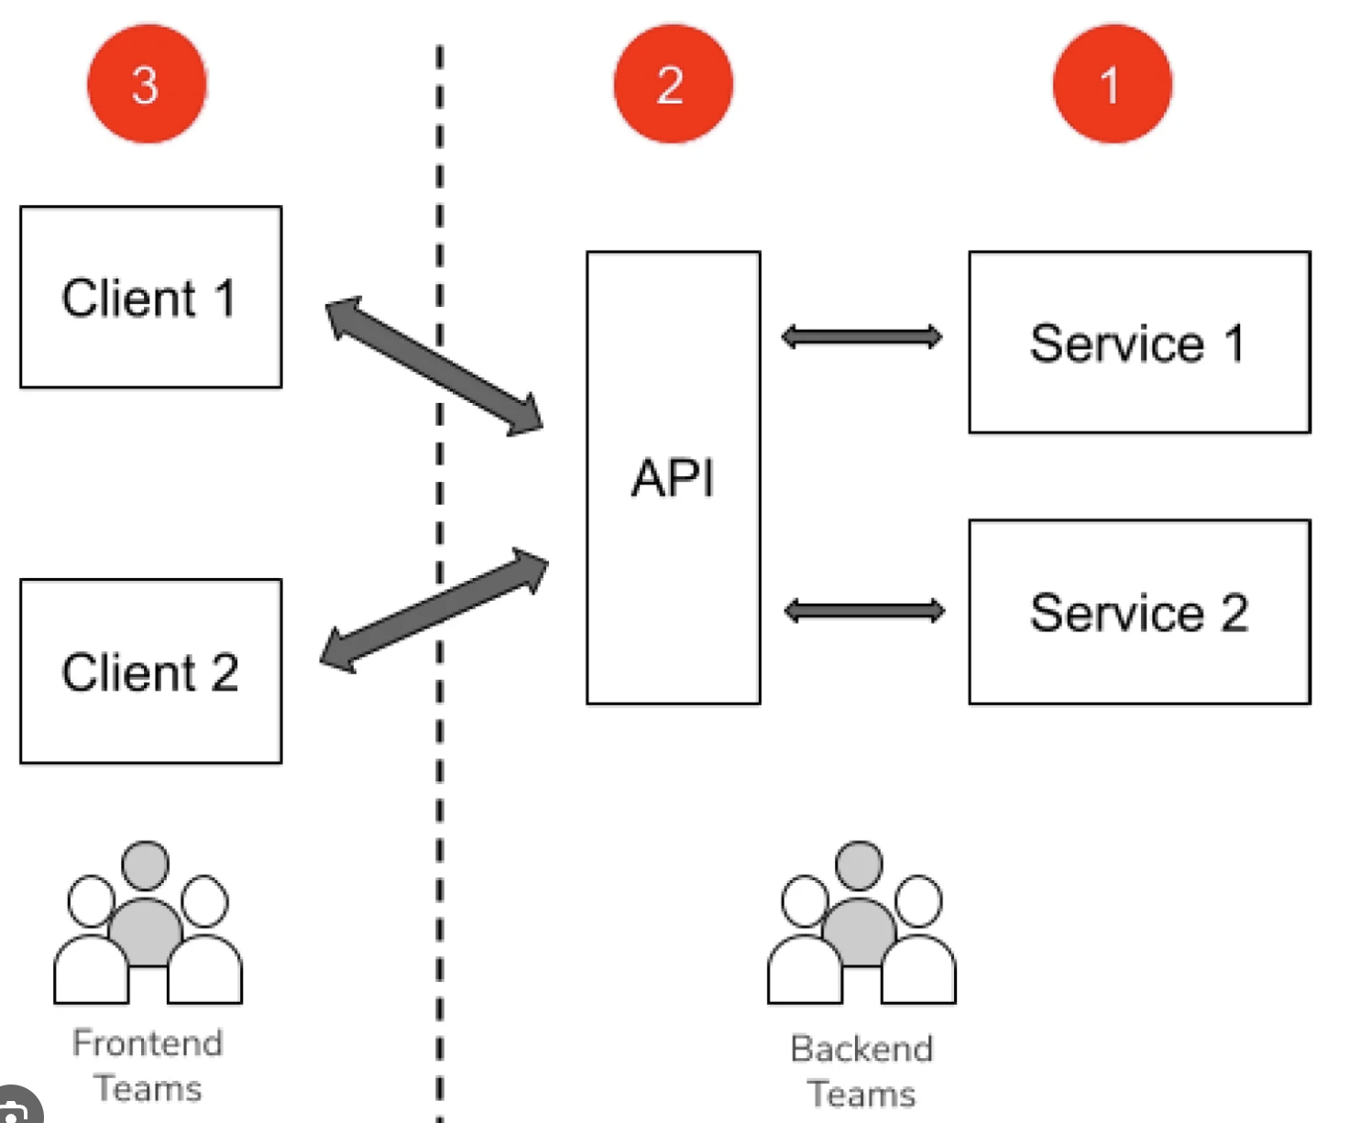

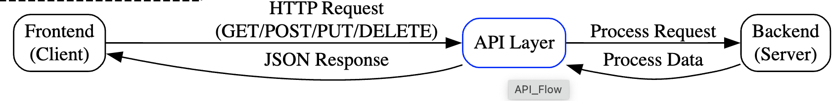
Frontend and Backend
Communication Flow (通信フロー) API
Purpose (目的)
Enable communication between systems
Standardize data exchange
Hide complex implementation details

Slide 15
Frontend and Backend
Communication Flow (通信フロー) API
Purpose (目的)
Enable communication between systems
Standardize data exchange
Hide complex implementation details

Slide 16
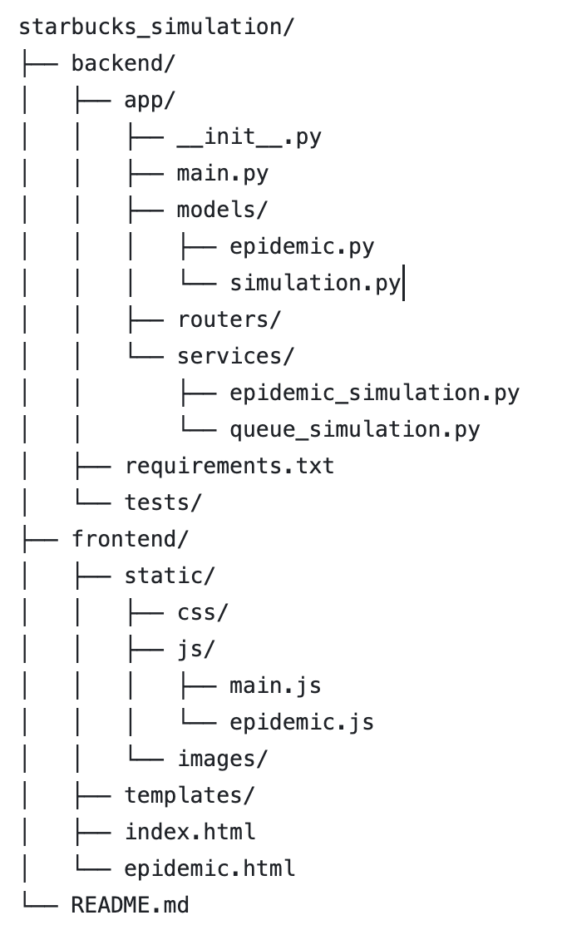
Frontend and Backend
A project
Defined
- Data type
- parameters
Backend
Defined
API
Defined
our algorithms
Frontend
Defined
style of webpage
Defined
logic of webpage
Readme file
Defined
Layout of webpage

Slide 17
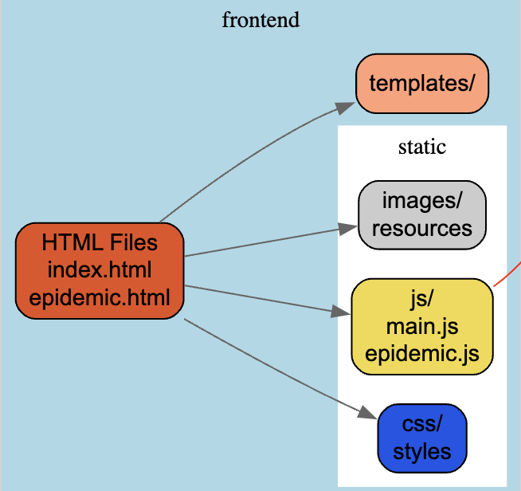
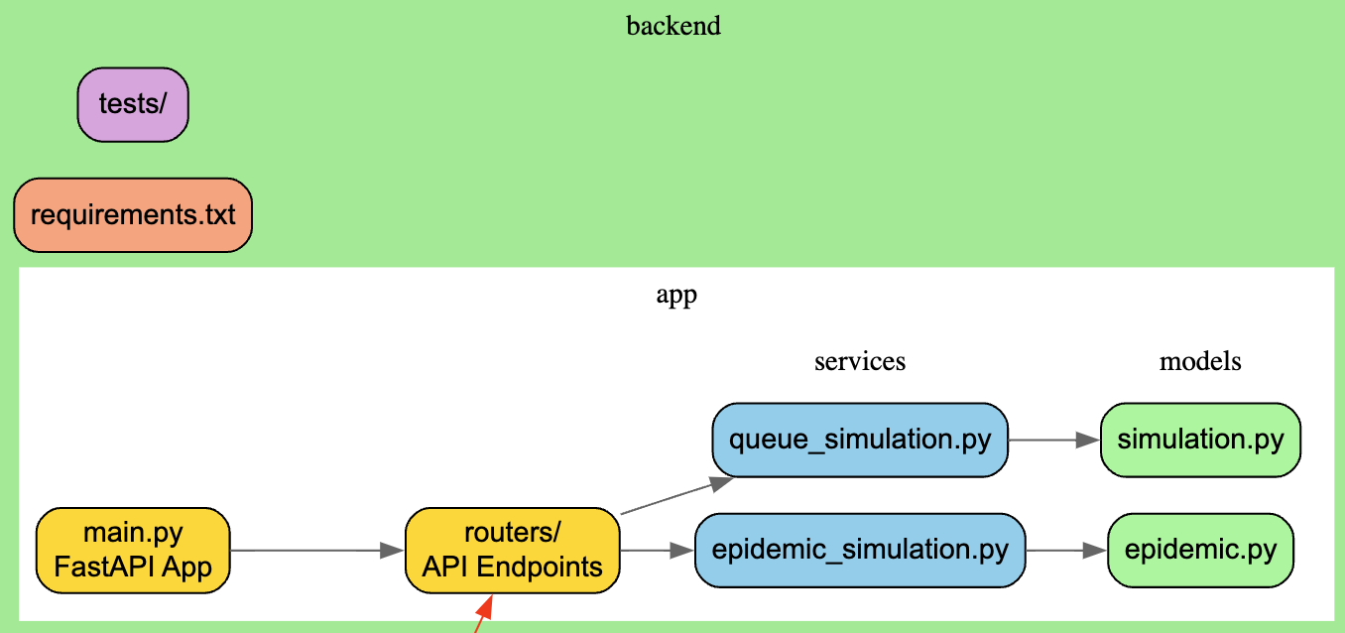
Frontend and Backend How data communicate

Slide 18
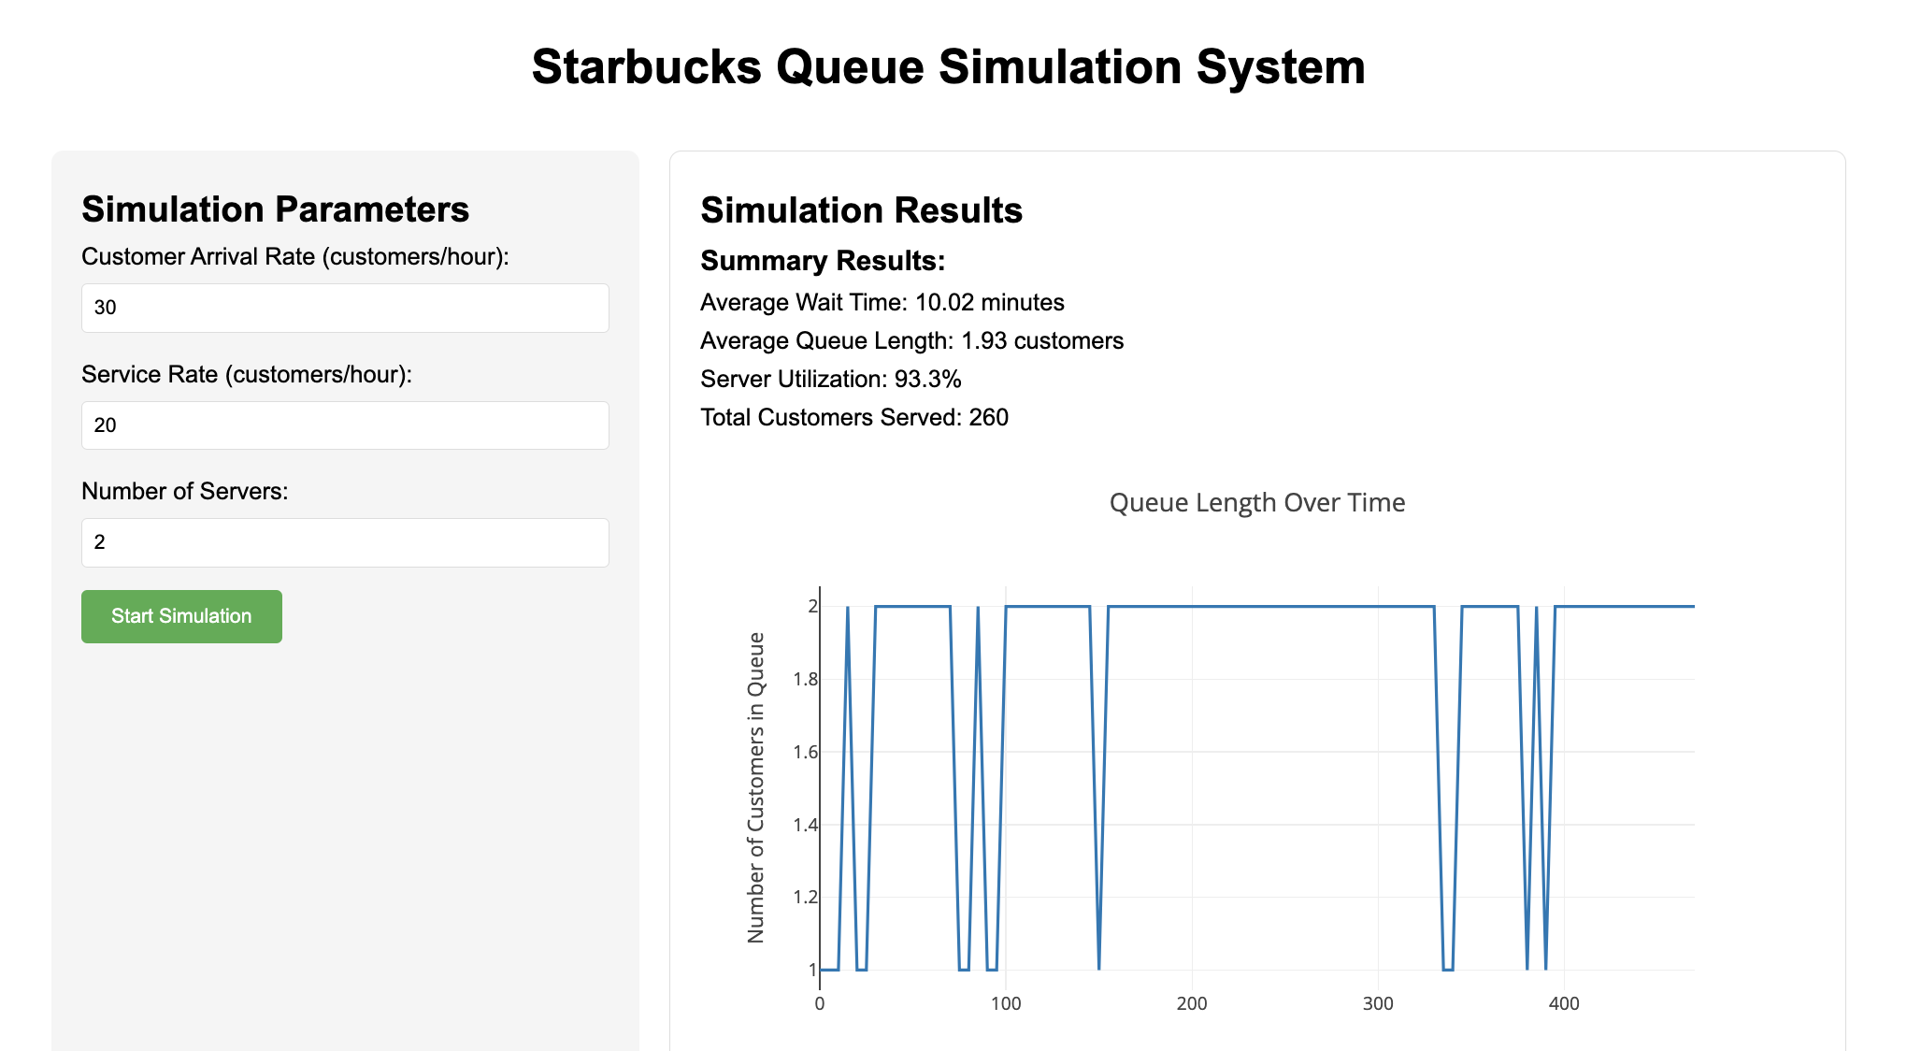
Frontend and Backend How data communicate
1. Open a the github
https://github.com/Terryzhang-jp/simulation_sample.git
2. Follow Readme.md

Slide 19
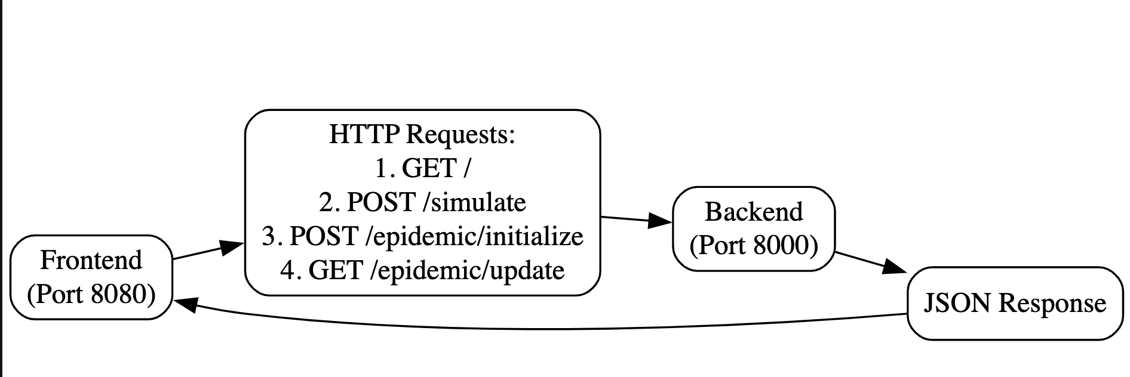
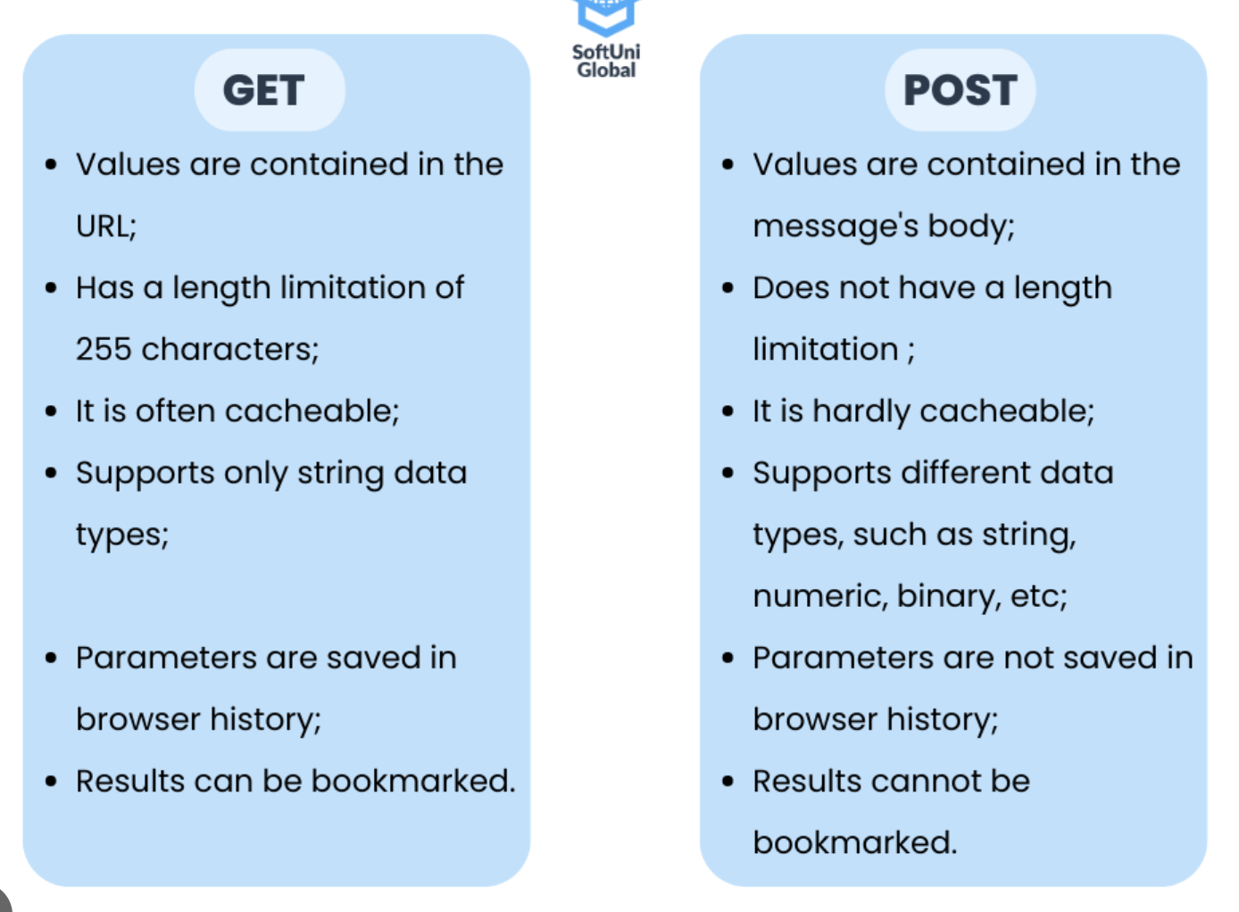
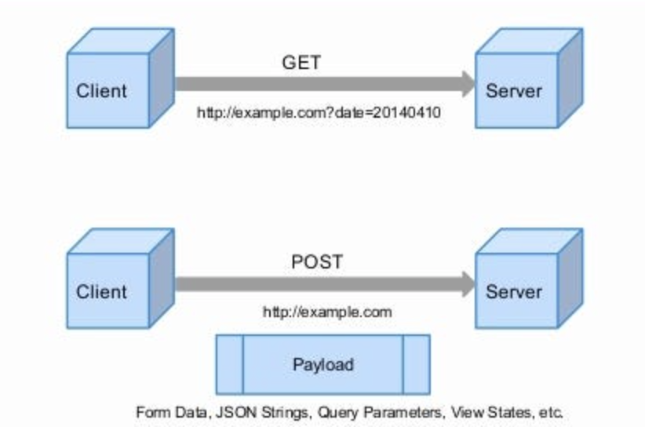
Frontend and Backend How data communicate
Anyone knows “GET” and “POST”?

Slide 20
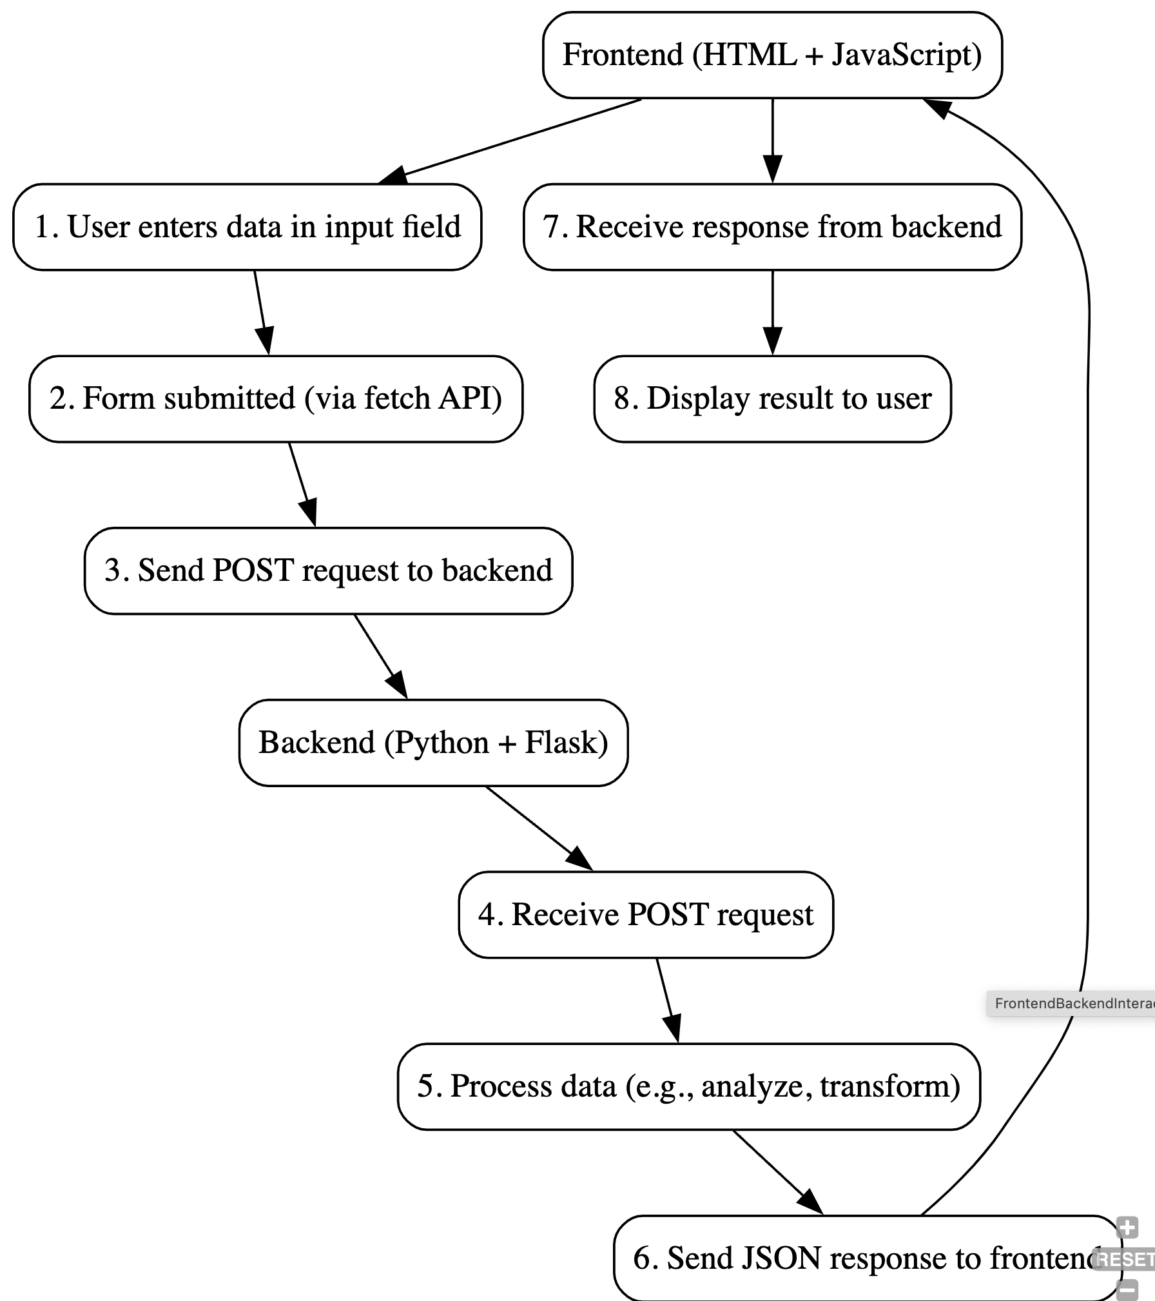
Frontend and Backend How data communicate

Slide 21
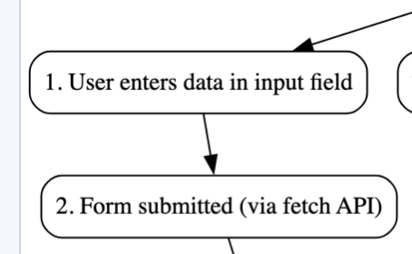
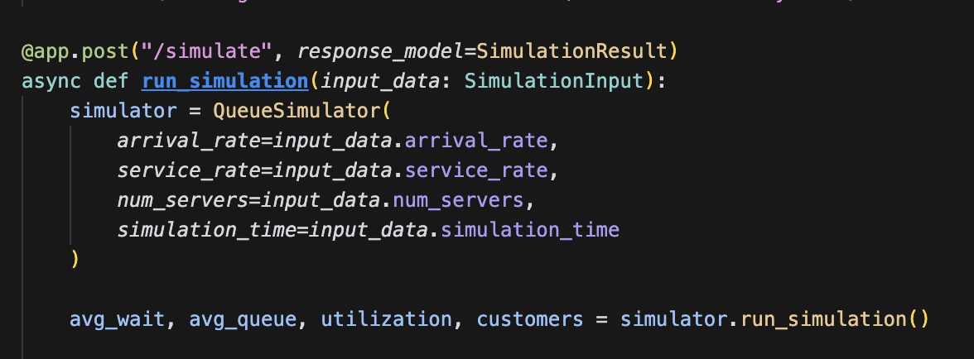
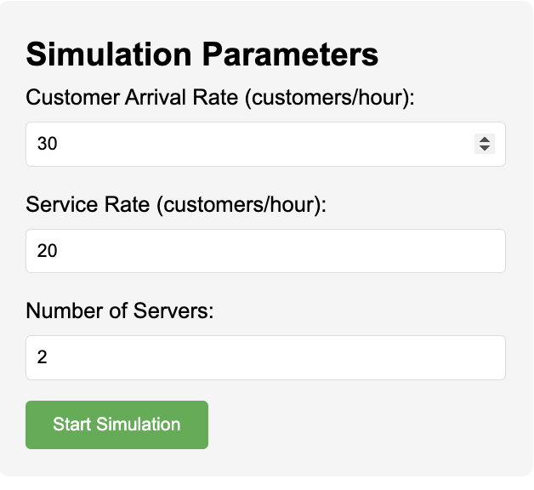
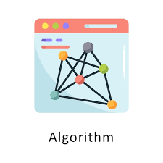
Frontend and Backend How data communicate
Backend (js)
Frontend (js)
http://localhost:8000/simulate
{
"arrival_rate": 30,
"service_rate": 20,
"num_servers": 2,
"simulation_time": 480}
results (js)
{
"average_wait_time": 12.5,
"average_queue_length": 8.3,
"server_utilization": 0.75,
"total_customers_served": 240,
"time_points": [0, 30, 60, 90, ...],
"queue_lengths_over_time": [0, 5, 8, 6, ...],
"wait_times_over_time": [0, 10, 15, 12, ...],
"server_utilization_over_time": [0.5, 0.6, 0.8, 0.7, ...]
}
Frontend (js)
fetch the results
fetch('http://localhost:8000/simulate'

Slide 22
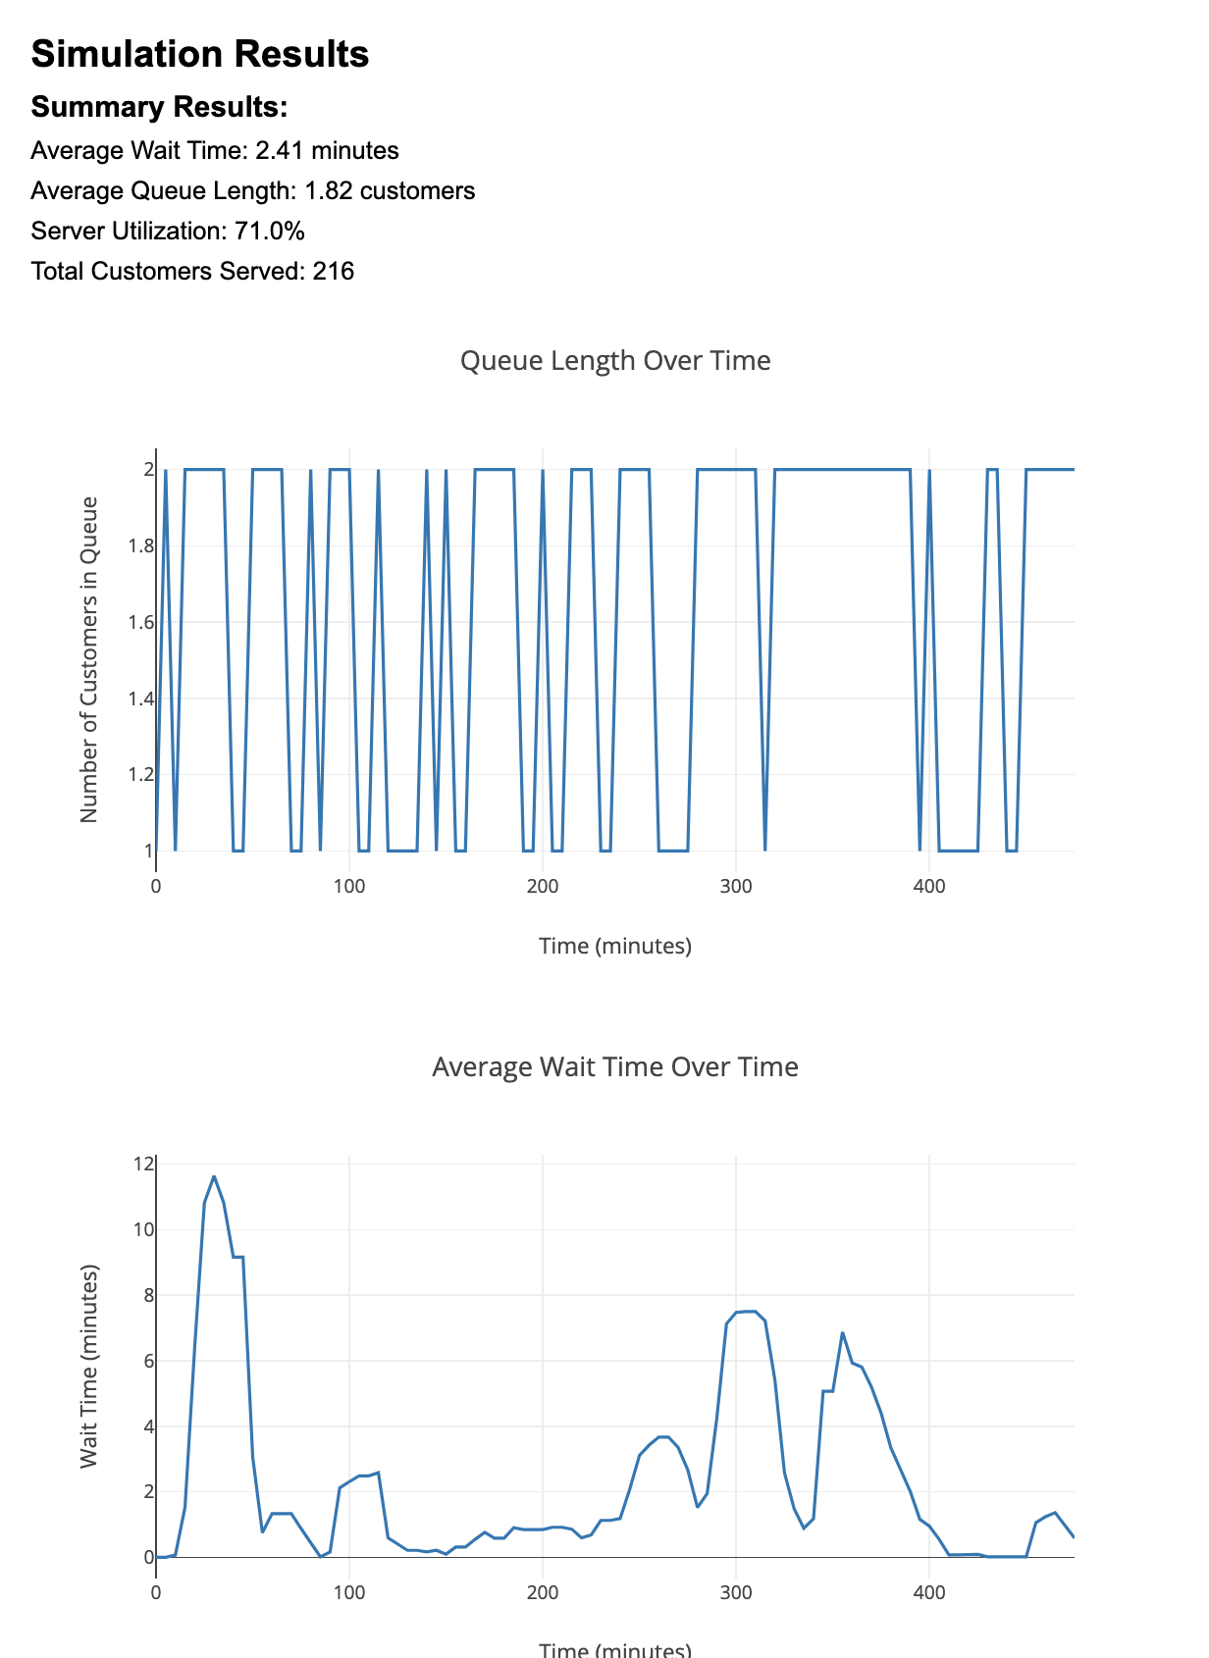
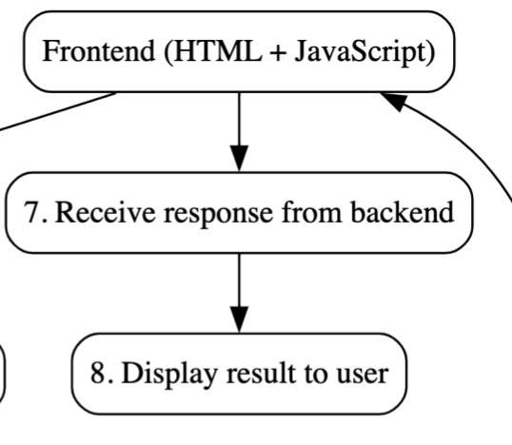
Frontend and Backend How data communicate
Frontend (js)
fetch the results
fetch('http://localhost:8000/simulate'

Slide 23
Question & Discuss？
http://127.0.0.1:8080/epidemic.html
Please visit this webpage
Run the simulation
Can you tell me what is the process for this agent based simulation to update?

Slide 24
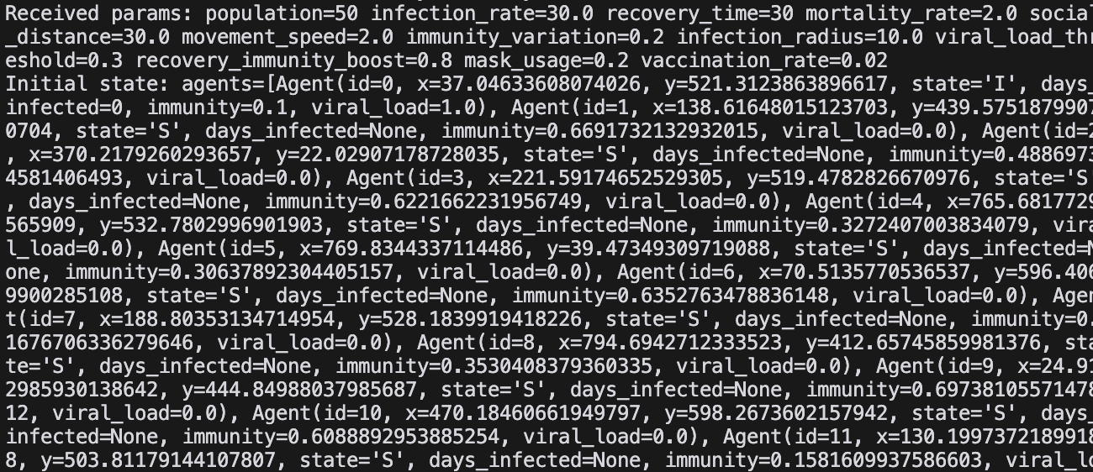
Question & Discuss？
It returns the simulation status for every agent as json file.
c

Slide 25
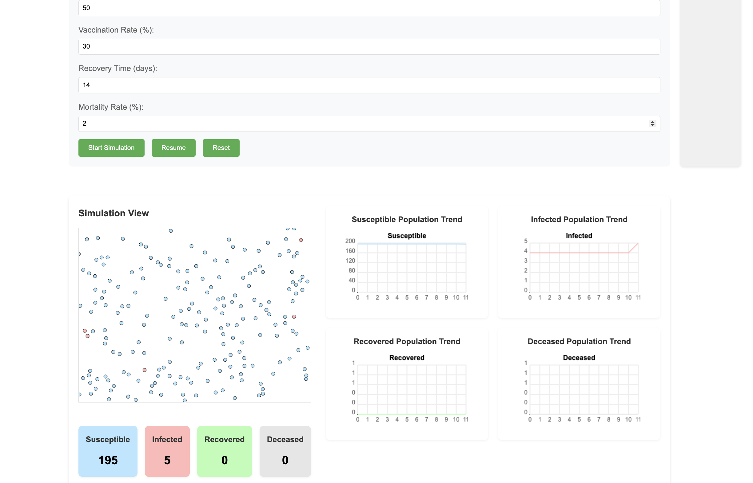

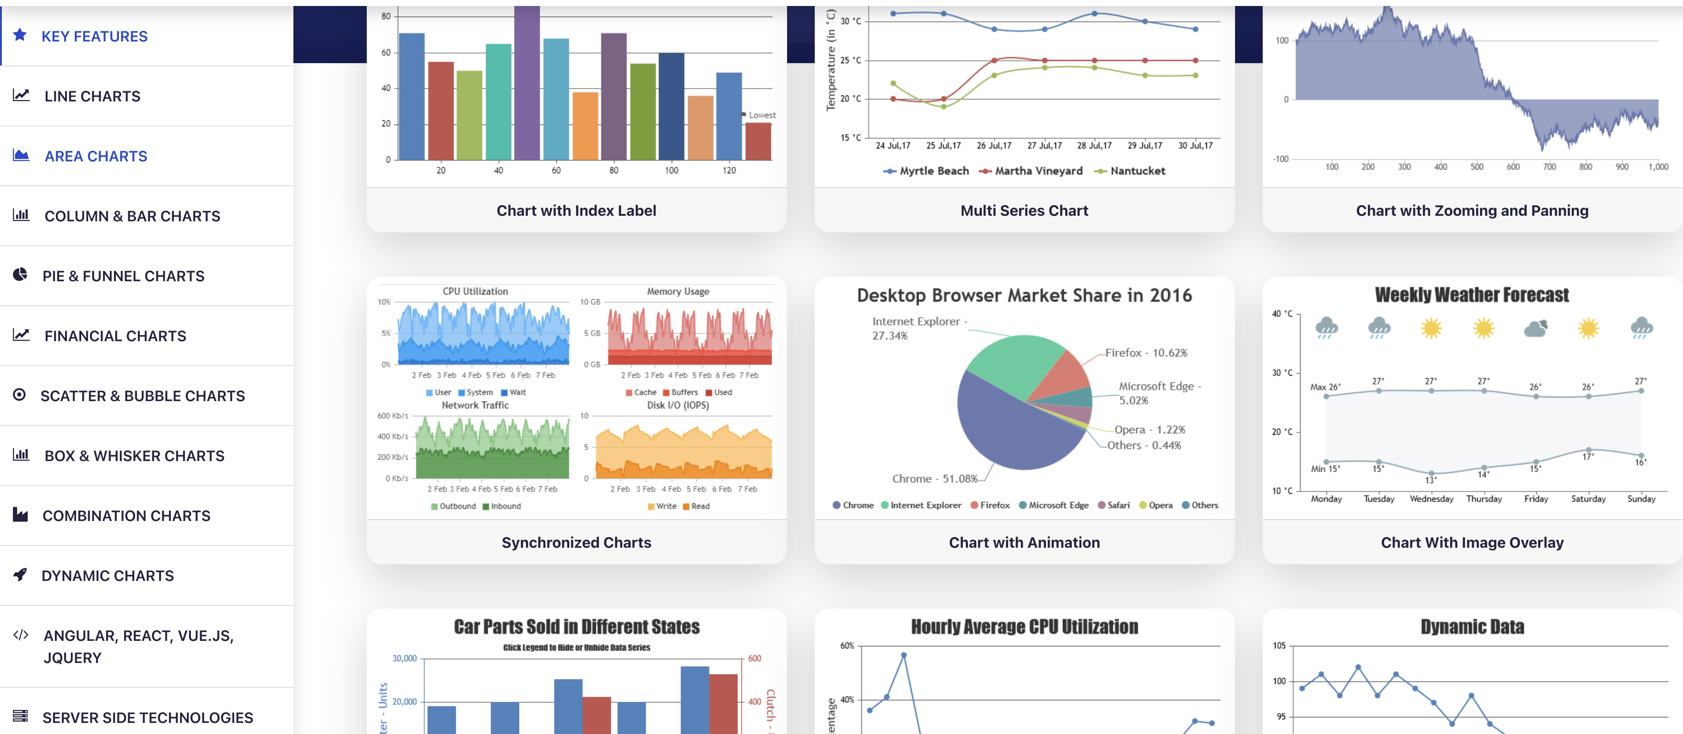
Question & Discuss？
In this simulation we did not use any package for visualization, but only javascript and html.
https://canvasjs.com/

Slide 26
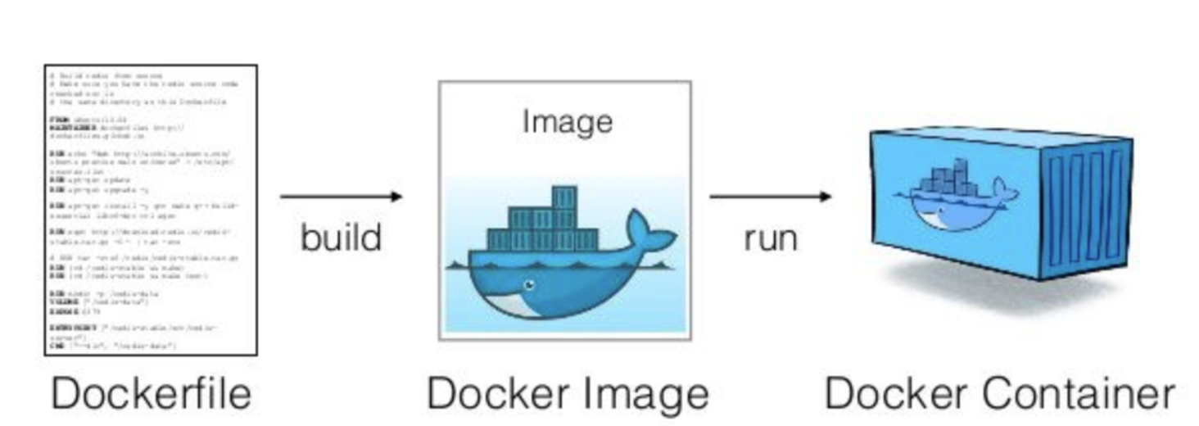


How to deploy online
You hava a project already
AWS
GCP Azure

Slide 27

How to deploy online
Dockerfile:
It's like a recipe (how to cook this dish)
Recipe that defines how to prepare and cook your dish
YAML:
It's like a restaurant management manual (how many servings to make and how to serve)
Manual that specifies serving quantities and service procedures

Slide 28
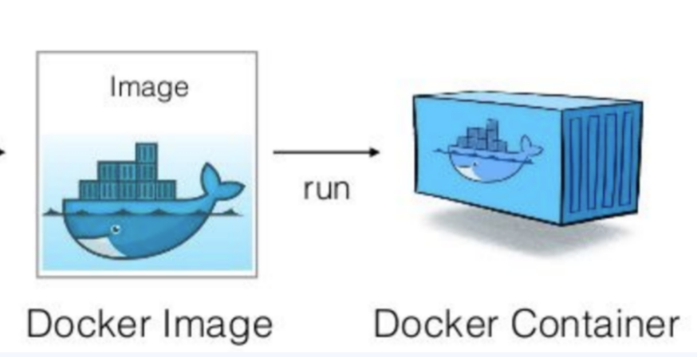
How to deploy online
Image (イメージ) = レシピの設計図
レストランの標準的なレシピのような
必要な材料と手順がすべて含まれている
他のシェフやレストランと共有可能
Container (コンテナ) = 実際に提供される料理
イメージの実行インスタンス
同じレシピから複数の料理が作れる
各料理は独立している
Image = Recipe Template
Like a standardized recipe in a restaurant
Contains all ingredients and instructions
Can be shared with other chefs/restaurants
Container = Actual Served Dish
Running instance of an image
Can make multiple dishes from same recipe
Each dish is independent

Slide 29


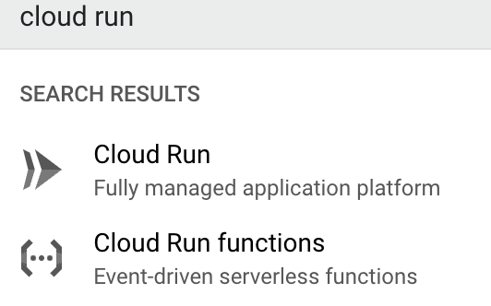
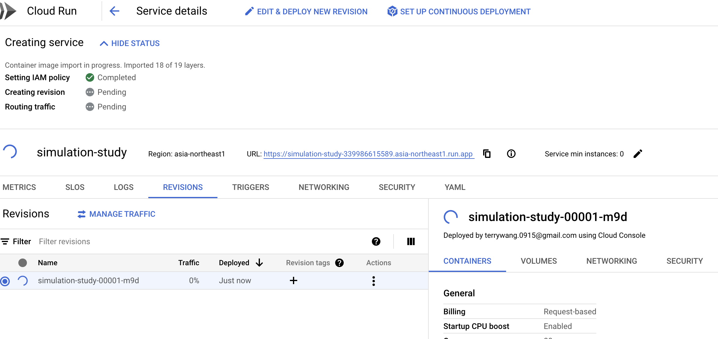
How to deploy online
docker.io/terryzhang627/simulation-study:latest
Deploy
Done

